Slide 1
R-NET: MACHINE READING COMPREHENSION WITH SELF-MATCHING NETWORKS
Natural Language Computing Group
Microsoft Research Asia
ACL 2017

Slide 2
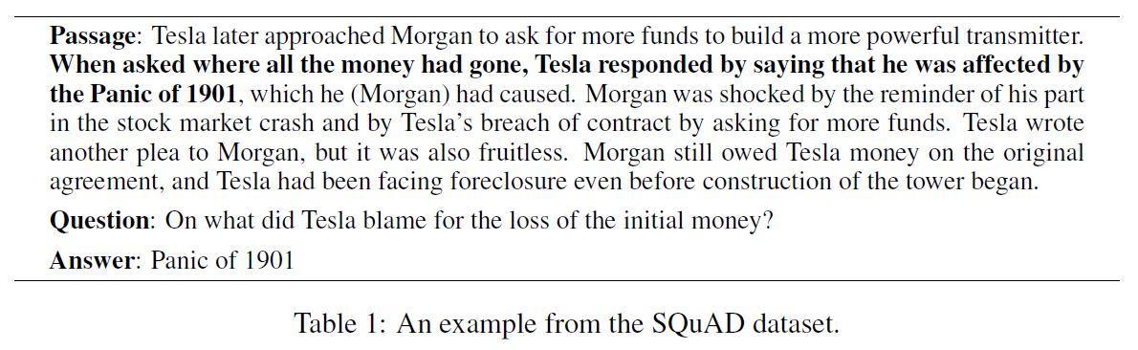
SQuAD

Slide 3
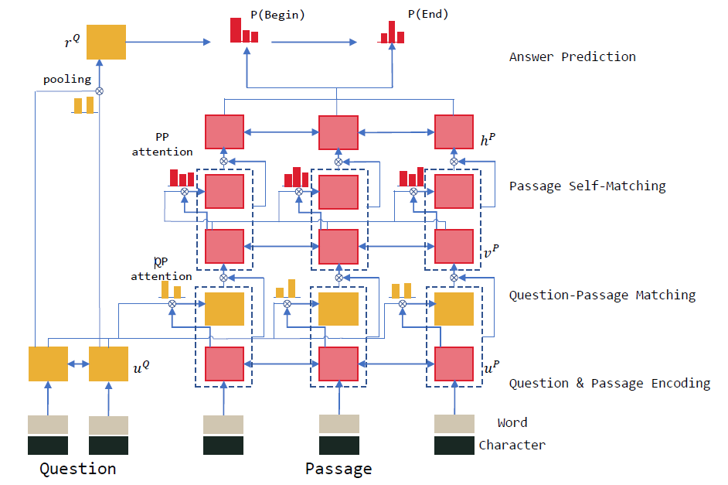
R-NET structure

Slide 4




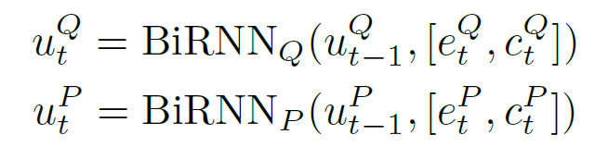
QUESTION AND PASSAGE ENCODER
Consider a question and a passage
Convert the words to their respective word-level embeddings
and character-level embeddings

Slide 5
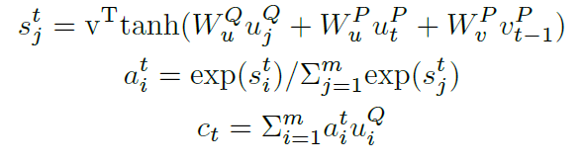


GATED ATTENTION-BASED RECURRENT NETWORKS
Rocktaschel et al. (2015)
Wang & Jiang (2016a)

Slide 6
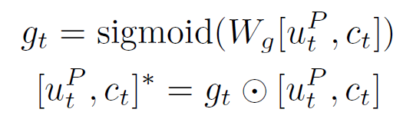
GATED ATTENTION-BASED RECURRENT NETWORKS

Slide 7
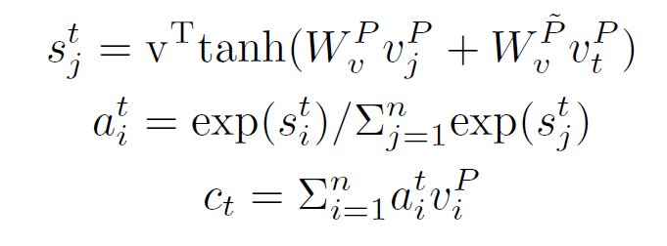

SELF-MATCHING ATTENTION
Passage context is necessary to infer the answer. To address this problem, we propose directly matching the question-aware passage representation against itself

Slide 8
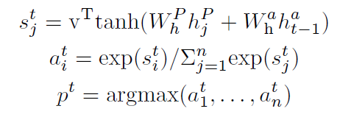
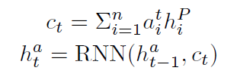
OUTPUT LAYER

Slide 9
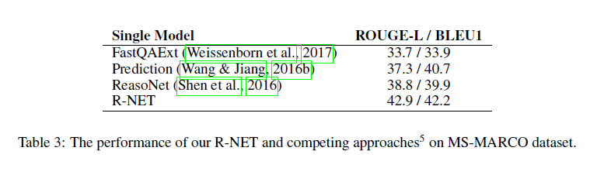
EXPERIMENT

Slide 10
